Slide 1
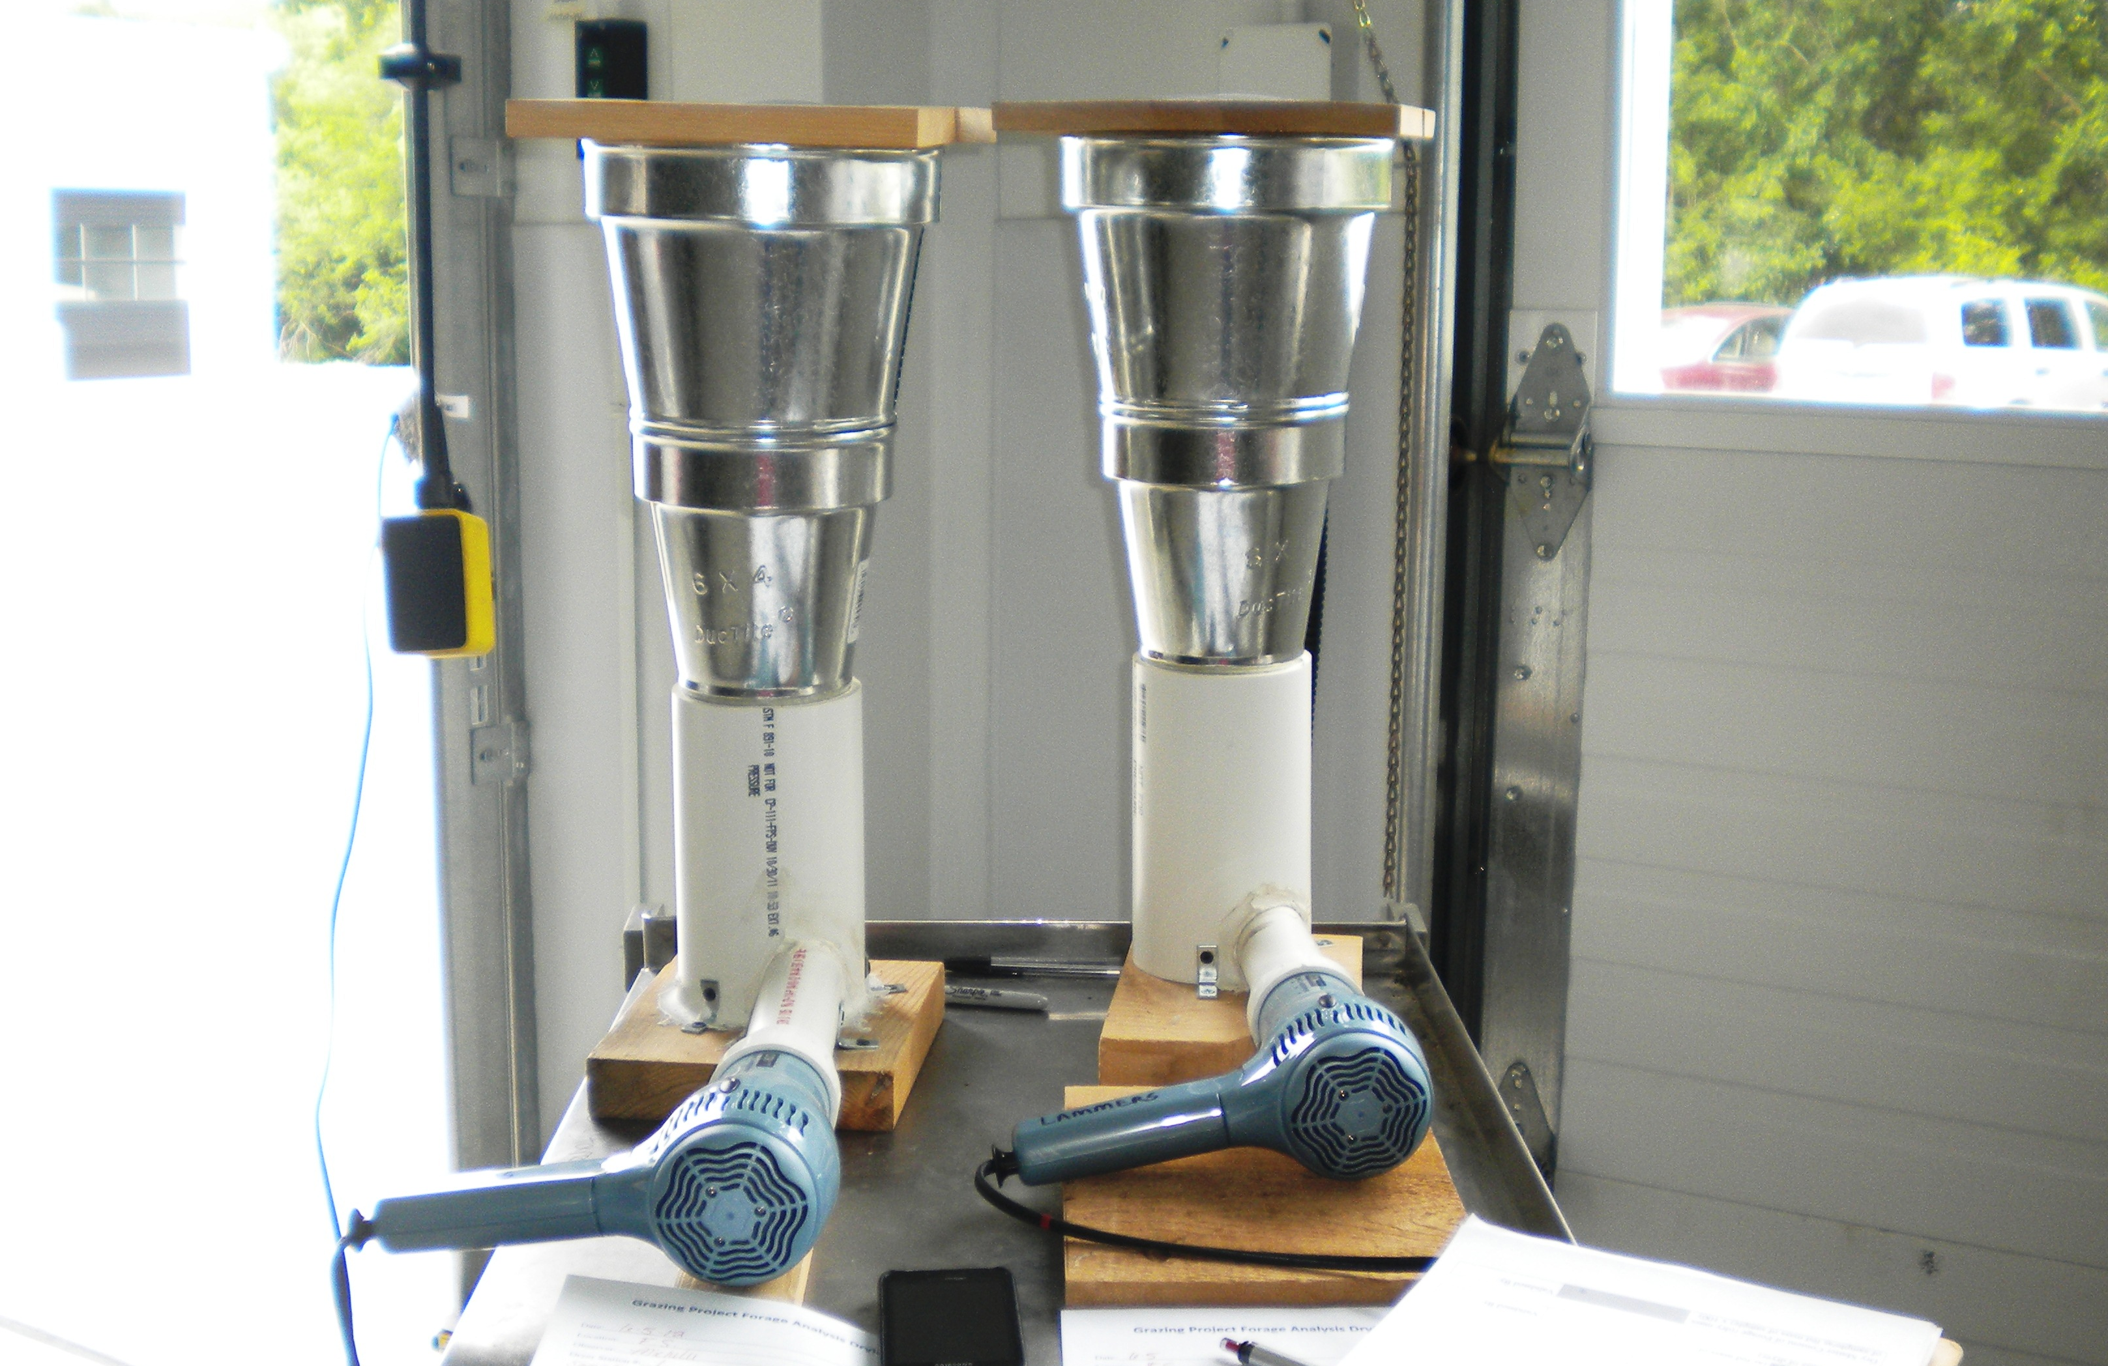
College of Veterinary Medicine
Michelle Christianson¹, Peter Lammers², Renee Dewell¹, Jessica Juarez¹, Suzanne Millman¹
¹Department of Veterinary Diagnostic and Production Animal Medicine, Iowa State University College of Veterinary Medicine, Ames, IA
²Department of Agriculture, Illinois State University, Normal IL
Quick and Cost Effective Forage Analysis for Grass Fed Beef
Figure 1. Falling plate meter.
Figure 2. Vortex forage dryer.
Figure 3. Chopping forage into 2.5 cm pieces with a paper cutter. .
Table 1. Average height of all samples collected monthly (centimeters).
Table 2. Average density of all samples on a monthly basis (kilograms/hectare).
Table 3. Linear regression equation determined from height and density.
Abstract
Consumer interest in grass-finished beef is high, and forage quality is an important factor to consider when finishing cattle on grass. To produce lean nutritious meat, animals must have access to high-quality forage. Animal grazing patterns must be carefully controlled and monitored to optimize grassland quality and availability. Accurate measurement of forage availability helps determine stocking rate and rotation frequency. This project demonstrates a low-cost, simplified approach to measuring forage dry matter content and predicting pasture yield. A low-cost falling plate meter developed by West Virginia Extension Service (Rayburn & Lozier, 2003) was used to determine forage height (cm.) and collect forage samples. Six locations were selected randomly in the pasture, the plate was gently lowered, height (cm.) was recorded, and grass was clipped and weighed (g). Samples were chopped with a paper cutter and a low cost vortex forage dryer designed by Pennsylvania State was used to dry samples to determine percent dry matter. The vortex dryer is inexpensive and more mobile than a conventional dryer (Buckmaster, 2005). Sample collection occurred monthly in May, June, and July. Forage density (kg/hectare) was computed and a linear regression equation was derived to compare forage height and density. The resulting equation was y = 561.29 x – 1703.5, where x represents forage height (cm.) and y represents forage yield (kg of dry matter/hectare). While the linear regression equation applies to the grassland used for this study, one could easily duplicate these methods to determine kilograms of dry matter per hectare in their pasture. Equipment costs in this study were nominal and each item can easily be recreated to determine percent dry matter, and to compute a personalized linear regression equation to aid in optimal pasture management for grass-fed beef.
Introduction
Forage management is extremely important to producing high quality beef. Accurate measurement of forage availability helps determine stocking rate and rotation frequency. This study demonstrated the use of two tools:
1.) The falling plate meter
2.) The vortex forage dryer
Both tools can assist producers in accurately determining forage dry matter content and predicting pasture yield for better pasture management.
Materials and Methods
Field Collection of Forage
Collection of forage was done using a falling plate meter which measures the height of the forage. There is a high correlation between forage height and dry matter, and the correlation increases when forage is pressed with a weighted plate (Rayburn & Lozier, 2003).
The falling plate meter was made of acrylic plastic, a yard stick, and two pieces of heavy string as depicted in Figure 1.
The cost was approximately $20.00.
Samples of forage were collected monthly for May, June, and July. For each collection 6 samples of forage were taken.
This was done by randomly selecting a location, standing the yard stick up, and gently lowering the plate onto of the forage until the plate was supported. The height of the forage was determined by measuring the height of the plate above the ground.
After measuring the height of the forage a sample that represented the size of the plate was collected.
Each sample was numbered, put in a bag and taken to the farm office to be weighed. A small gram scale was used to determine the as fed mass of each sample. The mass was recorded and the samples were taken to the drying facility (Field Services Building, Iowa State University College of Veterinary Medicine).
Forage Drying
All samples were dried within 24 hours of collection to maintain uniformity. A low cost vortex forage and biomass sample dryer was used.
Materials and Methods continued
The dryer was made using a blow dryer, PVC, heating ducts, furnace filter, window screen, wood, and fastening hardware.
The cost of the vortex forage dryer was approximately $40.00 with the major cost being the blow dryer at $16.00.
The vortex dryer was made according to the instructions in Buckmaster’s article, “A Vortex Forage and Biomass Sample Dryer”. Figure 2 shows two vortex drying stations built to Buckmaster’s specifications.
For the drying process each sample was chopped into 2.5 cm pieces with a paper cutter as shown in Figure 2. The entire chopped sample was mixed and a representative 200 gram sub-sample was dried.
The start time was recorded. After 15 minutes the sample was re-weighed and time was recorded again.
After this, weight and time were recorded every five minutes until the same mass was recorded three times in a row.
The following equations were used to calculate percent dry matter:
Dry Mass of Sample (g) = (dryer + dry sample (g)) – dryer (g)
%Dry Matter = (dry mass of sample (g) / original mass of sample (200 g) ) x 100
Results
Table 1 shows the height of forage was tallest in June (34.29 cm) and shortest in July (24.66 cm).
Table 2 shows the density of forage. June has the highest density ( 6183.07 kg/hectare) and July has the lowest density (4786.57 kg/hectare).
The linear regression line in table 3 shows positive linear correlation between height (cm) and density (kg/hectare), with a linear regression equation of y = 561.29 x – 1703.5.
Conclusions
The bell curve shape within both Table 1 and Table 2 are very similar, this is due to the fact that height and density are positively correlated.
The positive linear regression equation is a tool that can be used to estimate pasture yield for the grazing season.
All tools used in this project were inexpensive. The falling plate meter and vortex dryer cost $65.00. Both items were easy to recreate and the supplies are commonly found in a hardware store.
This method does not take into consideration rain fall or soil quality and does not estimate nutritional content of the forage. However, it does provide a reliable estimate of the forage mass available in a given pasture, which is an important first step to improving pasture management. Regular analysis of the nutritional content of grazed forage may further improve the precision of pasture management and should be considered further.
Acknowledgements
Funds for this project have been provided by the Leopold Center for Sustainable Agriculture and the Iowa Livestock Health Advisory Council (ILHAC).
References
Buckmaster, D. R. (2005). A vortex forage and biomass sample dryer. Penn State College of Agricultural Sciences Cooperative Extension Agricultural and Biological Engineering, I(101), 1-6. Retrieved from http://pubs.cas.psu.edu/freepubs/pdfs/I101.pdf
Buckmaster, D. R. (2005). A vortex forage and biomass sample dryer. The Society for Engineering in Agricultural, Food, and Biological Systems . ASAE Paper No. 051049. St. Joseph, Mich.: 1-8.
Rayburn, E., & Lozier, J. (2003). A falling plate meter for estimating pasture forage mass. Extension
Service West Virginia University, Retrieved from http://www.caf.wvu.edu/~forage/fallplate.pdf

